Slide 1
NatioID
National Digital Identity & Voting Platform
Web & Mobile Application
Presented by: Abdulazeez Adam.A
Contact: abdulazeezadam09@gmail.com

Slide 2
Project Overview
NatioID – Unified Digital Identity & Voting Platform-
A centralized platform for secure digital identification and voting.
Designed for government agencies, election bodies, and citizens.
Solves inefficiencies and fraud in traditional ID and voting systems.
Dual interfaces: Admin Dashboard and Citizen Portal.
Scalable for national-level elections and population-wide identity management.
Accessible on:
- Web: Built with React + Vite
- Mobile: Developed using Expo (React Native)

Slide 3
Problem Statement & Goal
❌Problems Identified
• Manual ID registration and voting processes are prone to fraud, delays, and errors.
• Lack of a centralized system for citizen data and election oversight.
• Limited transparency and real-time access for both voters and administrators.
• Many young citizens do not have Voter IDs, making it hard to engage in elections.
• Physical voting increases risk of violence, fights, and even loss of life at polling stations.
• Low youth participation — many see voting as stressful, time-wasting, or feel disconnected.
🎯 Project Goal
To build a secure, unified, and accessible digital platform for citizen identity and electronic voting, promoting transparency and trust in governance.

Slide 4
KEY Features
🔐 Admin Portal (Web App)
- Manage citizens and ID applications
- Create, edit, and launch elections
- Monitor live voting results
- Control candidate data & campaigns
- Handle and escalate complaints
- Admin user management
🧍 Citizen Portal (📱 Mobile App - Expo)
- Apply for National ID
- Vote in elections securely
- View candidate campaigns
- Submit feedback and complaints

Slide 5
Technical Architecture
• Frontend (Web): React + Vite + Tailwind CSS
• Mobile: Expo + React Native
• Hosting: Vercel (Web), EAS Build (Mobile)
Routing: React Router (Web), Expo Router (Mobile)
📝Note:
This version uses dummy hardcoded data only, with no real backend or live API integration (for demonstration purposes).

Slide 6
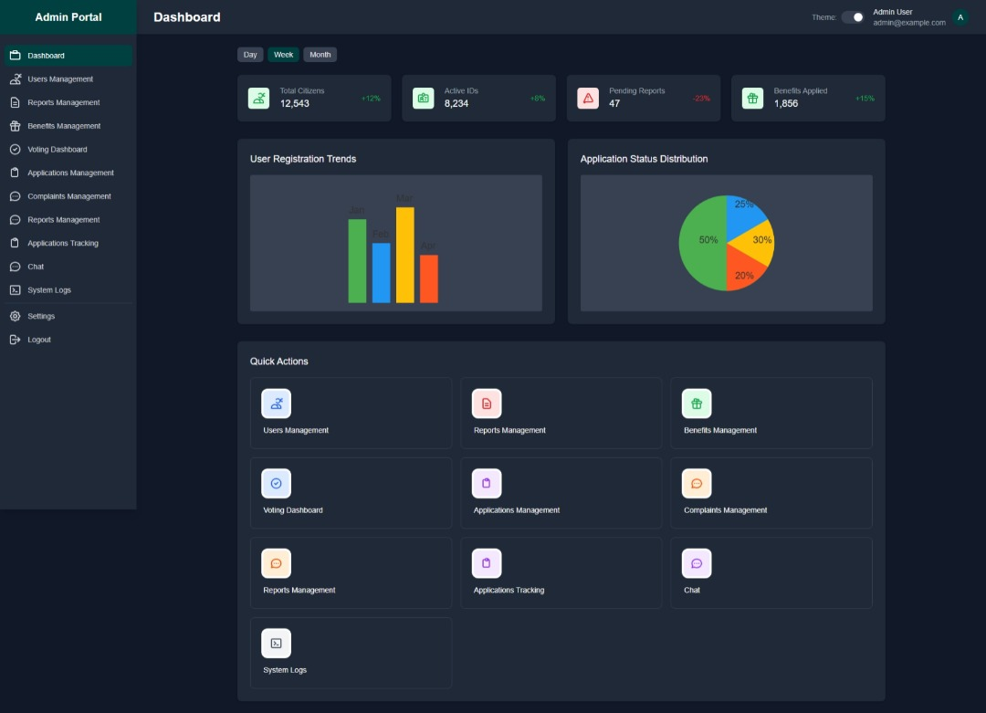
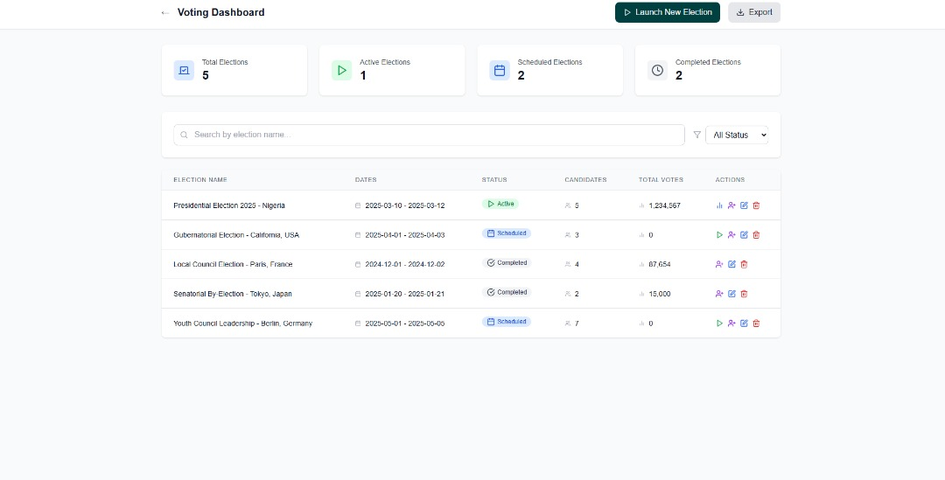
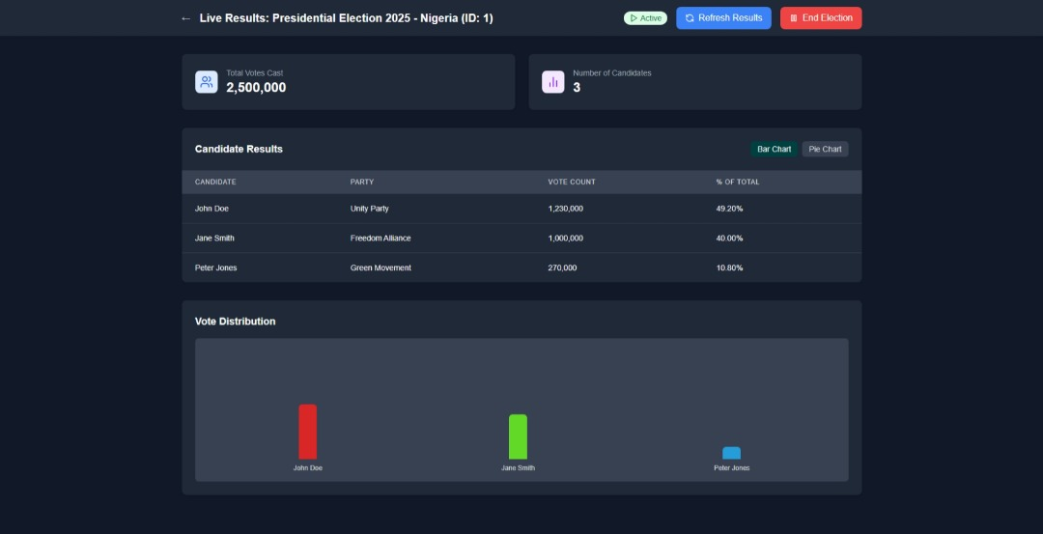
Admin Dashboard – Screenshots
• Dashboard Overview
• Manage Elections & Candidates
• View Real-Time Results

Slide 7
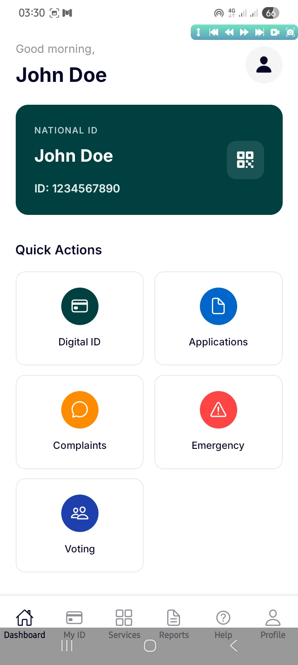
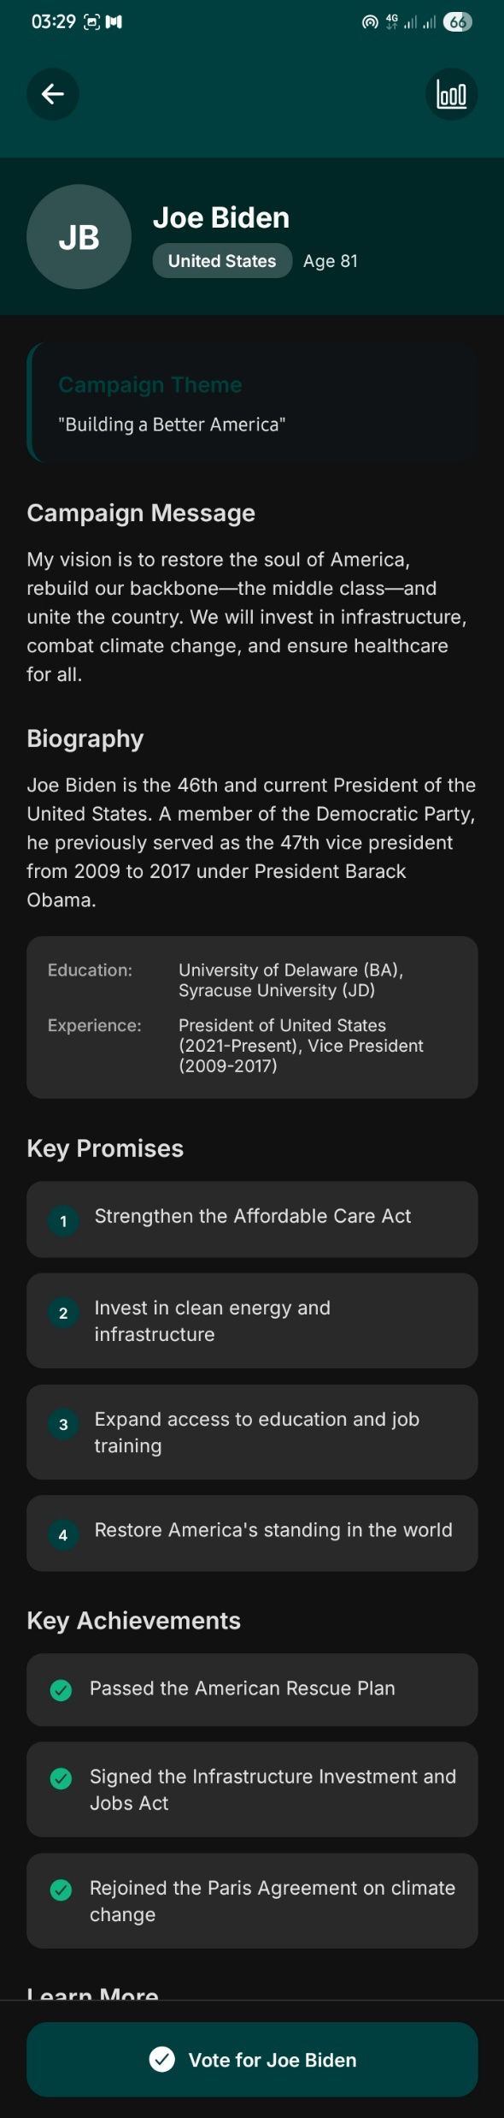
Citizen App – Screenshots
• Dashboard
• View Candidate Campaigns
• Vote with One Tap

Slide 8
System Flow
🧍 Citizen Portal (Mobile App)
Register / Login
View Elections
Vote in Active Elections
View Candidate Campaigns
- Submit Complaints - Access Digital ID
🔐 Admin Portal (Web App)
Login & Manage Admins
Create / Edit Elections
Add / Manage Candidates
Monitor Live Results
Manage Complaints
View Registered Citizens
- Launch / End Elections

Slide 9
Security & Privacy
Admin (Web App):
Role-Based Access Control
Secure HTTPS Communication
- Optional: Session Timeout & UI Blur on Inactivity
Citizen (Mobile App):
- Screenshot Restriction
Planned: OTP Verification & Biometric Linking
Device-based Access (No login roles)
Secure Voting Flow (no duplicate votes)
Note: Some features are simulated with hardcoded data; no real backend or auth service is implemented.

Slide 10
Deployment & Accessibility
• Web: https://natio-id.vercel.app
• Mobile (.apk): https://expo.dev/accounts/ainfiniti/projects/natioid/builds/f66d46db-007c-4da7-9cda-db6db180115e
• Platform compatibility: - Web app(Admin): Runs on any modern browser (Windows, macOS, Linux),
desktop-only (Not responsive) — Intentional for security + usability control.
Mobile app (Expo + React Native) currently supports Android.
- iOS support is planned for future builds, pending additional resources.

Slide 11
Limitations / Roadmap
• Currently frontend-only (no real backend/API; uses dummy data).
• Limited to Android (iOS version planned).
• No persistent database — data resets on reload.
• Biometric & OTP login planned for future security.
• Admin authentication is basic; will be upgraded to secure login.
• No real-time updates yet (e.g., WebSocket or polling).
• Push notifications for election reminders and updates (planned).
• Backend integration and data encryption (future phase).
• Offline support for mobile (future consideration).
Note: This is a prototype MVP — focused on structure and usability

Slide 12
Call to Action
Seeking funding to support backend development, security features, and deployment at scale.
Open to pilot programs with government agencies, electoral bodies, or civic tech organizations.
Welcoming partnerships with NGOs, policy makers, or tech incubators working on digital governance.
Available for demos, presentations, or feedback sessions.
Let’s collaborate to make digital identity and voting secure, inclusive, and accessible.

Slide 13
Who Is This For?
Government agencies overseeing national elections.
Electoral commissions managing voter identity and results.
NGOs and civil society organizations focused on electoral integrity.
Technology partners or sponsors interested in secure civic platforms.
Citizens needing a reliable digital voting channel.

Slide 14
Why NatioID Matters
Reduce election fraud through centralized digital ID.
Increase transparency with real-time result monitoring.
Encourage youth participation with mobile voting access.
Eliminate polling unit violence and manual error.
Replace scattered paper-based systems with unified digital infrastructure.

Slide 15
User Journey Overview
Citizen:
Register with personal details via mobile app.
View available elections.
Cast secure vote.
Track results.
Admin:
Create elections.
Add/manage candidates.
Monitor results in real time.
Respond to complaints.

Slide 16
Thank You
We appreciate your time and attention.
Questions or feedback? We're happy to discuss.
Contact: abdulazeezadam09@gmail.com
GitHub: https://github.com/Ainfiniti01/NatioID
Docs folder: Contains feature writeups, screenshots, and license.
Presentation resources available on request.

